Slide 1
I/O Devices and Drivers
Lars Ailo Bongo, Inf-2201,UiT, Spring 2019
Based on slides from Kai Li and J.P. Singh, Princeton University
Also including figures from Modern Operating Systems by Tanenbaum, and images from www.intel.com

Slide 2
Outline
Revisit hardware
Device controllers
Programmed I/O
Direct memory access (DMA)
Device drivers design and implementation
Virtual reality kits

Slide 3
Input and Output
A computer’s job is to process data
Computation (CPU, cache, and memory)
Move data into and out of a system (between I/O devices and memory)
Challenges with I/O devices
Different categories: storage, networking, displays, etc.
Large number of device drivers to support
Device drivers run in kernel mode and can crash system
Goals of the OS
Provide a generic, consistent, convenient and reliable way to access I/O devices
As device-independent as possible
Don’t hurt the performance capability of the I/O system too much

Slide 4
Typical I/O Devices
Device | Bandwidth
Keyboard | 10 bytes/sec
Mouse | 100 bytes/sec
External Hard drive (USB 3.0) | 640 MByte/sec
Gigabit Ethernet | 125 MByte/sec
SATA 3 Hard drive | 600 MByte/sec
Graphics card (PCI-Express 2.0 bus) | 1 GByte/sec
Microphone (bluetooth)
External DAC (USB 2.0) | 60 Mbyte/sec
3G/4G adapter | 8.1 Mbyte/sec
Camera
Printer | Kbyte
Touch screen
Virtual reality kit

Slide 5
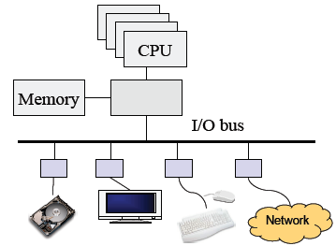
Revisit Hardware
Compute hardware
CPU and caches
Chipset
Memory
I/O Hardware
I/O bus or interconnect
I/O controller or adaptor
I/O device
Two types of I/O
Programmed I/O (PIO)
CPU does the work of moving data
Direct Memory Access (DMA)
CPU offloads the work of moving data to DMA controller

Slide 6
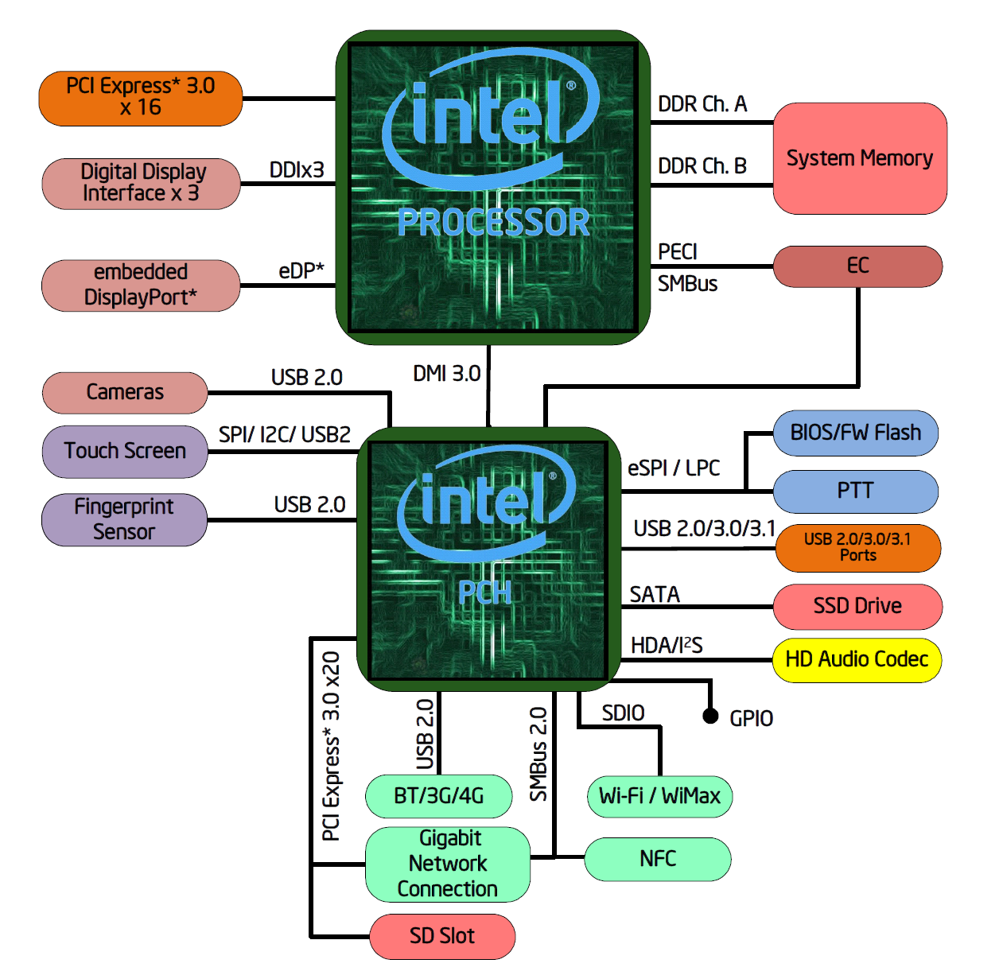
My laptop

Slide 7

Definition and General Method
Overhead
Time that the CPU is tied up initiating/ ending an operation
Latency
Time to transfer one bit (typically byte)
Overhead + 1 bit reaches destination
Bandwidth
Rate of I/O transfer, once initiated
Mbytes/sec
General method
Higher level abstractions of byte transfers
Batch transfers into block I/O for efficiency to amortize overhead and latency over a large unit

Slide 8
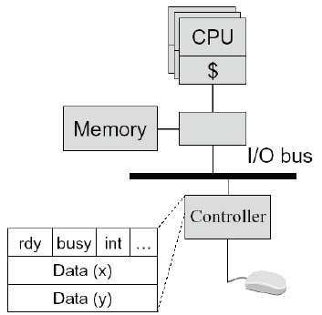
Programmed Input Device
Device controller
Status register ready: tells if the host is done busy: tells if the controller is done int: interrupt …
Data registers
A simple mouse design
Put (X, Y) in data registers on a move
Interrupt
Input on an interrupt
Read values in X, Y registers
Set ready bit
Wake up a process/thread or execute a piece of code

Slide 9
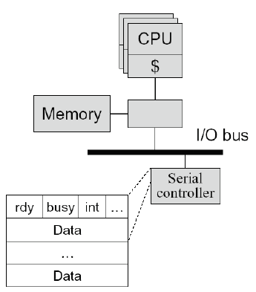
Programmed Output Device
Device
Status registers (ready, busy, … )
Data registers
Example
A serial output device
Perform an output
Wait until ready bit is clear
Poll the busy bit
Write the data to register(s)
Set ready bit
Controller sets busy bit and transfers data
Controller clears the ready bit and busy bit

Slide 10
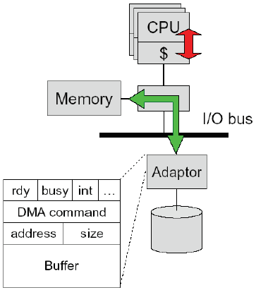
Direct Memory Access (DMA)
DMA controller or adaptor
Status register (ready, busy, interrupt, …)
DMA command register
DMA register (address, size)
DMA buffer
Host CPU initiates DMA
Device driver call (kernel mode)
Wait until DMA device is free
Initiate a DMA transaction (command, memory address, size)
Block
Controller performs DMA
DMA data to device (size--; address++)
Interrupt on completion (size == 0)
Interrupt handler (on completion)
Wakeup the blocked process

Slide 11
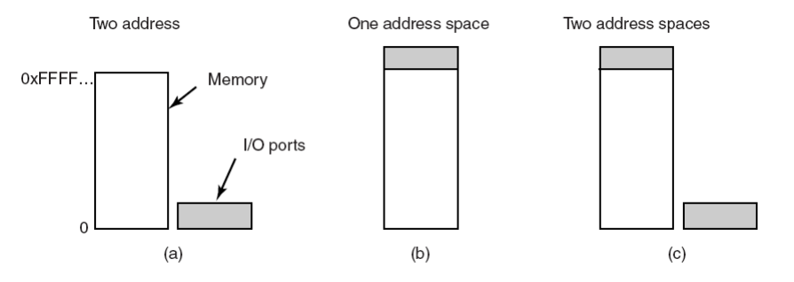
Memory-mapped I/O
How does the CPU communicate with the I/O controller?
I/O ports: special I/O instructions
Memory-mapped I/O: ordinary read and writes
Advantages/ disadvantages?

Slide 12
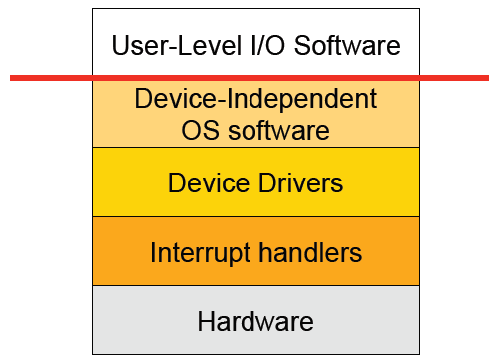
I/O Software Stack

Slide 13
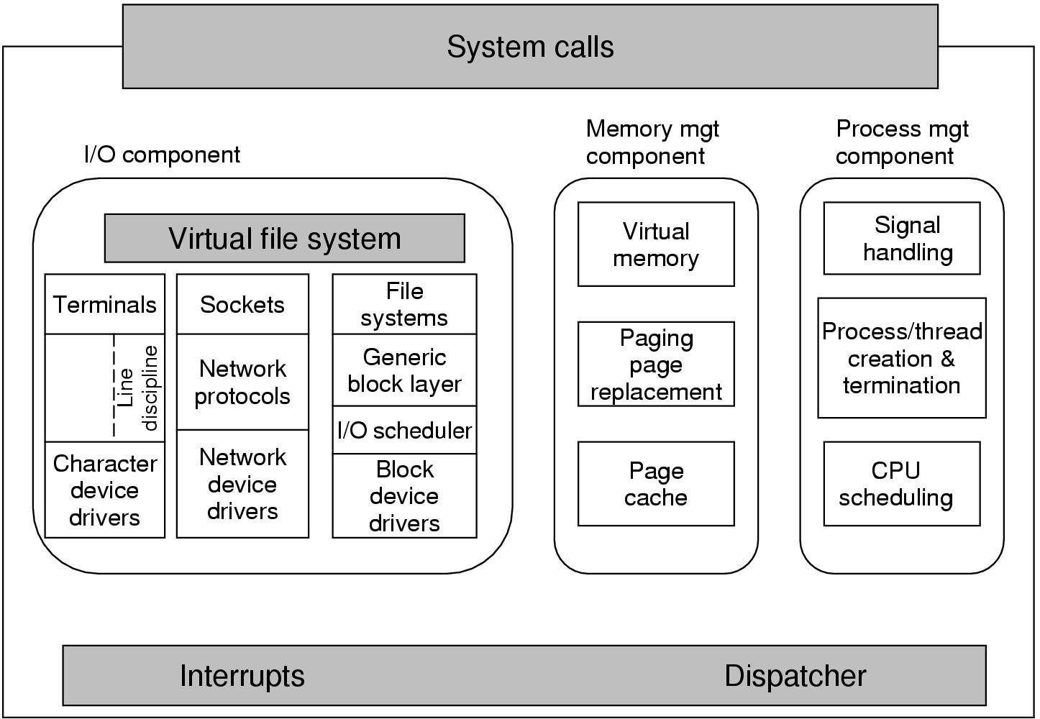
Linux Kernel Structure

Slide 14
Windows Kernel Structure

Slide 15
Windows Hardware Abstraction Layer

Slide 16
Recall Interrupt Handling
Save context (registers that hw hasn’t saved, PSW etc)
Mask interrupts if needed
Set up a context for interrupt service
Set up a stack for interrupt service
Acknowledge interrupt controller, perhaps enable it
Save entire context to PCB
Run the interrupt service
Unmask interrupts if needed
Possibly change the priority of the process
Run the scheduler
Then OS will set up context for next process, load registers and PSW, start running process …

Slide 17
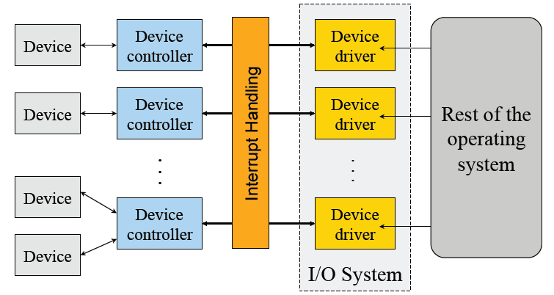
Device Drivers
Manage the complexity and differences among specific types of devices (disk vs. mouse, different types of disks …)
Each handles one type of device or small class of them (eg SCSI)

Slide 18
Typical Device Driver Design
Operating system and driver communication
Commands and data between OS and device drivers
Driver and hardware communication
Commands and data between driver and hardware
Driver responsibilities
Initialize devices
Interpreting commands from OS
Schedule multiple outstanding requests
Manage data transfers
Accept and process interrupts
Maintain the integrity of driver and kernel data structures

Slide 19
Simplified Device Driver Behavior
Check input parameters for validity, and translate them to device-specific language
Check if device is free (wait or block if not)
Issue commands to control device
Write them into device controller’s registers
Check after each if device is ready for next (wait or block if not)
Block or wait for controller to finish work
Check for errors, and pass data to device-independent software
Return status information
Process next queued request, or block waiting for next
Challenges:
Must be reentrant (can be called by an interrupt while running)
Handle hot-pluggable devices and device removal while running
Complex and many of them; bugs in them can crash system

Slide 20
Types of I/O Devices
Block devices
Organize data in fixed-size blocks
Transfers are in units of blocks
Blocks have addresses and data are therefore addressable
E.g. hard disks, solid state disks, CD-ROMs
Character devices
Delivers or accepts a stream of characters, no block structure
Not addressable, no seeks
Can read from stream or write to stream
Printers, network interfaces, terminals
Like everything, not a perfect classification
E.g. tape drives have blocks but not randomly accessed
Clocks are I/O devices that just generate interrupts

Slide 21
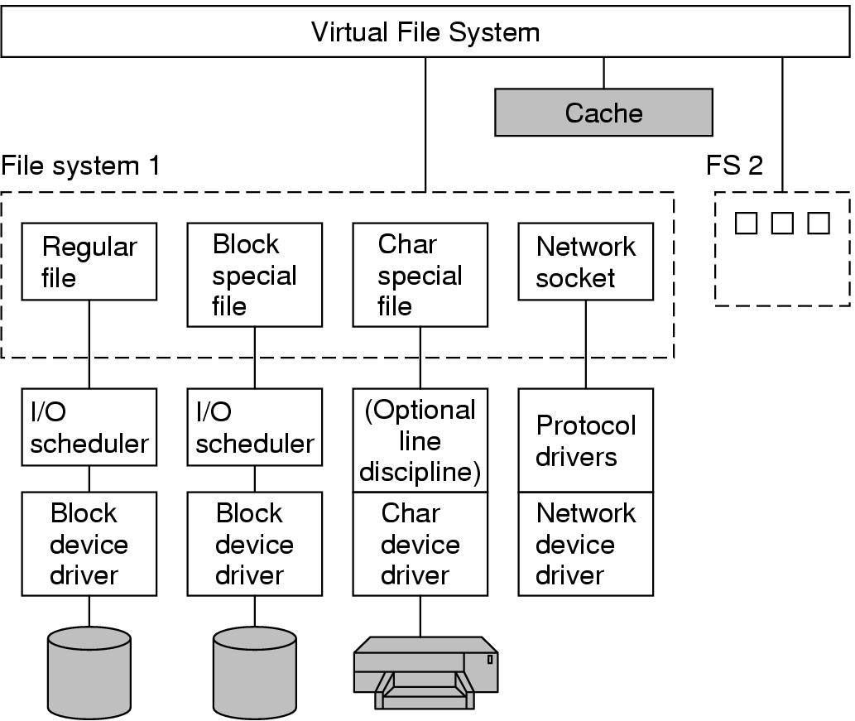
Input/ output in Linux

Slide 22
Windows Device Drivers Stack

Slide 23
Device Driver Interface
Open( deviceNumber )
Initialization and allocate resources (buffers)
Close( deviceNumber )
Cleanup, deallocate, and possibly turnoff
Device driver types
Block: fixed sized block data transfer
Character: variable sized data transfer
Terminal: character driver with terminal control
Network: streams for networking
Interfaces for block and character/stream oriented devices (at least) are different
Like to preserve same interface within each category

Slide 24
Character and Block Device Interfaces
Character device interface
read( deviceNumber, bufferAddr, size )
Reads “size” bytes from a byte stream device to “bufferAddr”
write( deviceNumber, bufferAddr, size )
Write “size” bytes from “bufferAddr” to a byte stream device
Block device interface
read( deviceNumber, deviceAddr, bufferAddr )
Transfer a block of data from “deviceAddr” to “bufferAddr”
write( deviceNumber, deviceAddr, bufferAddr )
Transfer a block of data from “bufferAddr” to “deviceAddr”
seek( deviceNumber, deviceAddress )
Move the head to the correct position
Usually not necessary

Slide 25
Unix Device Driver Interface Entry Points
init()
Initialize hardware
start()
Boot time initialization (require system services)
open(dev, flag, id) and close(dev, flag, id)
Initialization resources for read or write, and release afterwards
halt()
Call before the system is shutdown
intr(vector)
Called by the kernel on a hardware interrupt
read(…) and write() calls
Data transfer
poll(pri)
Called by the kernel 25 to 100 times a second
ioctl(dev, cmd, arg, mode)
special request processing

Slide 26
Synchronous vs. Asynchronous I/O
Synchronous I/O
read() or write() will block a user process until its completion
OS overlaps synchronous I/O with another process
Asynchronous I/O
read() or write() will not block a user process
user process can do other things before I/O completion
I/O completion will notify the user process

Slide 27
Detailed Steps of Blocked Read
A process issues a read call which executes a system call
System call code checks for correctness
If it needs to perform I/O, it will issues a device driver call
Device driver allocates a buffer for read and schedules I/O
Controller performs DMA data transfer
Block the current process and schedule a ready process
Device generates an interrupt on completion
Interrupt handler stores any data and notifies completion
Move data from kernel buffer to user buffer
Wakeup blocked process (make it ready)
User process continues when it is scheduled to run

Slide 28
Asynchronous I/O
API
Non-blocking read() and write()
Status checking call
Notification call
Different form the synchronous I/O API
Implementation
On a write
Copy to a system buffer, initiate the write and return
Interrupt on completion or check status
On a read
Copy data from a system buffer if the data are there
Otherwise, return with a special status

Slide 29
Why Buffering?
Speed mismatch between the producer and consumer
Character device and block device, for example
Adapt different data transfer sizes (packets vs. streams)
Deal with address translation
I/O devices see physical memory
User programs use virtual memory
Caching
Avoid I/O operations
User-level and kernel-level buffering
Spooling
Avoid user processes holding up resources in multi-user environment

Slide 30
Think About Performance
A terminal connects to computer via a serial line
Type character and get characters back to display
RS-232 is bit serial: start bit, character code, stop bit (9600 baud)
Do we have any cycles left?
What should the overhead of an interrupt be
Technique to minimize interrupt overhead
Interrupt coalescing

Slide 31
Other Design Issues
Build device drivers
Statically
A new device driver requires reboot OS
Dynamically
Download a device driver without rebooting OS
Almost every modern OS has this capability
How to down load device driver dynamically?
Load drivers into kernel memory
Install entry points and maintain related data structures
Initialize the device drivers

Slide 32
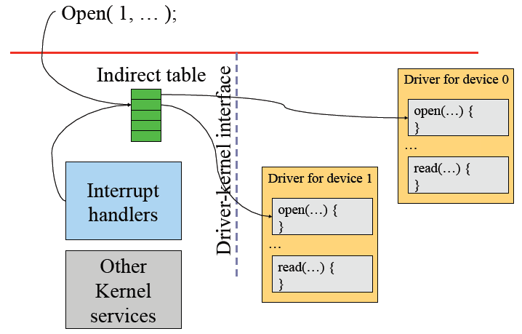
Dynamic Binding: Indirection

Slide 33
Windows Device Drivers

Slide 34
Issues with Device Drivers
Flexible for users, ISVs and IHVs
Users can download and install device drivers
Vendors can work with open hardware platforms
Dangerous methods
Device drivers run in kernel mode
Bad device drivers can cause kernel crashes and introduce security holes
Progress on making device driver more secure
Checking device driver codes
Build state machines for device drivers

Slide 35
Summary
Device controllers
Programmed I/O is simple but inefficient
DMA is efficient (asynchronous) and complex
Device drivers
Dominate the code size of OS
Dynamic binding is desirable for desktops or laptops
Device drivers can introduce security holes
Progress on secure code for device drivers but completely removing device driver security is still an open problem

Slide 36
Check out
I/O port programming:
LEDs on keyboard in P3
Keyboard driver in P4
Memory mapped I/O:
Print_char in P3
DMA:
Floppy driver in P4
Device driver:
Floppy driver in P4
Linux and Windows description in text book

